Slide 1

G2M Case Study
Virtual Internship
Name : Mohammad Odeh Location: United Arab Emirates Team: Data and Analytics Date: 11-March-2021

Slide 2
Background –G2M(cab industry) case study
XYZ is a private equity firm in US. Due to remarkable growth in the Cab Industry in last few years and multiple key players in the market, it is planning for an investment in Cab industry.
Objective : Provide actionable insights to help XYZ firm in identifying the right company for making investment.
The analysis has been divided into four parts:
Data Understanding
Forecasting profit and number of rides for each cab type
Finding the most profitable Cab company
Recommendations for investment

Slide 3
Data Exploration
16 Features( including 4 derived features)
Timeframe of the data: 2016-01-1 to 2018-12-31
Total data points :359392
Assumptions:
Outliers are present in Price_Charged feature but due to
unavailability of trip duration details ,we are not treating this as outlier.
Profit of rides are calculated keeping other factors constant and only
Price_Charged and Cost_of_Trip features used to calculate profit.
Users feature of city dataset is treated as number of cab users in the city.
we have assumed that this can be other cab users as well(including Yellow and
Pink cab)
Cab_Data.csv
Customer_ID.csv
Transaction_ID.csv
City.csv
Final cab data

Slide 4
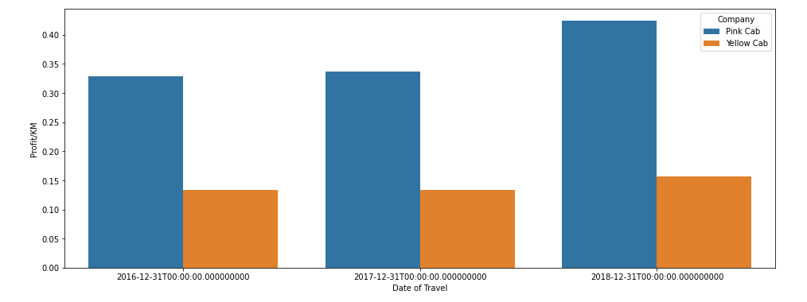
Profit Analysis
Profit Analysis
Pink Cab:
Profit: 5307328.32100
Rides: 84711
Profit/Ride: 62.65217
Profit/KM: 2.77715
Yellow Cab:
Profit: 44020373.17080
Rides: 274681
Profit/Ride: 160.25999
Profit/KM: 7.10073

Slide 5
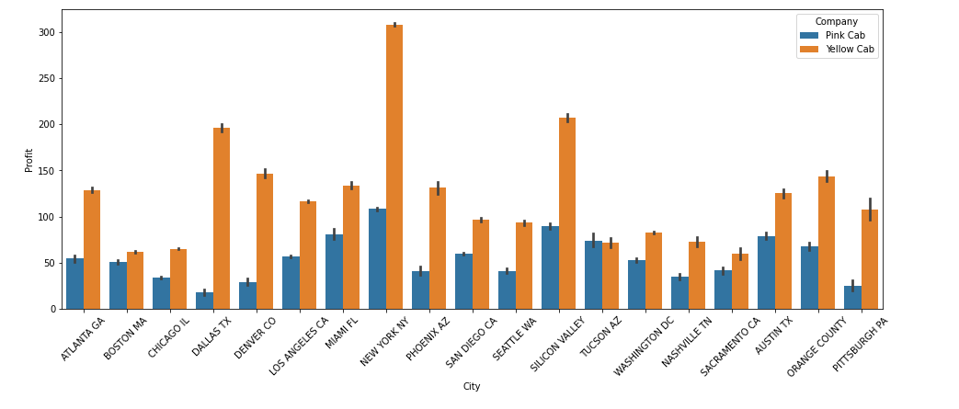
Profit Analysis
Profit Analysis

Slide 6
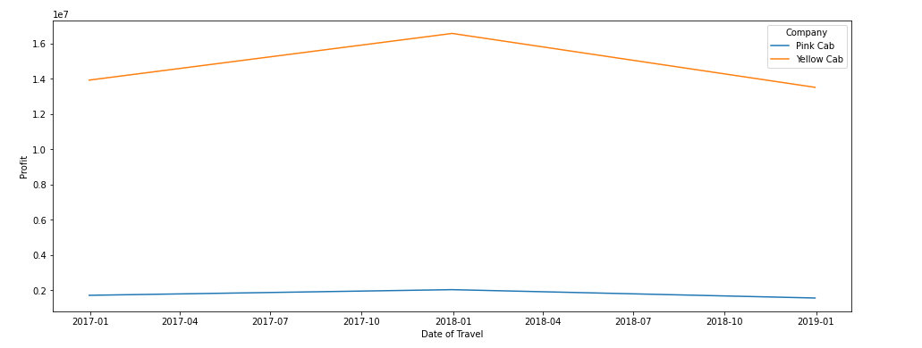
Yearly Profit Analysis

Slide 7
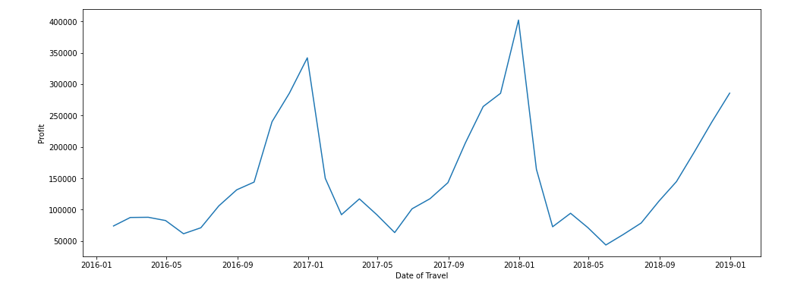
Monthly Profit Analysis
Yellow cab

Slide 8
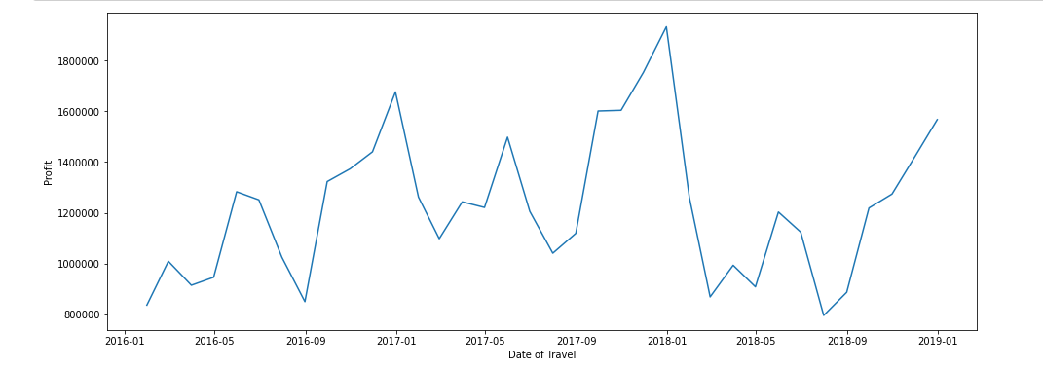
Monthly Profit Analysis
Pink cab

Slide 9
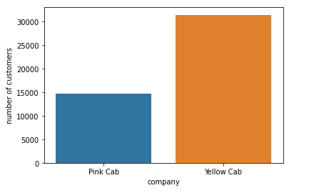
Number of Users per compay
Yellow Cab has more than more than double the number of customers

Slide 10
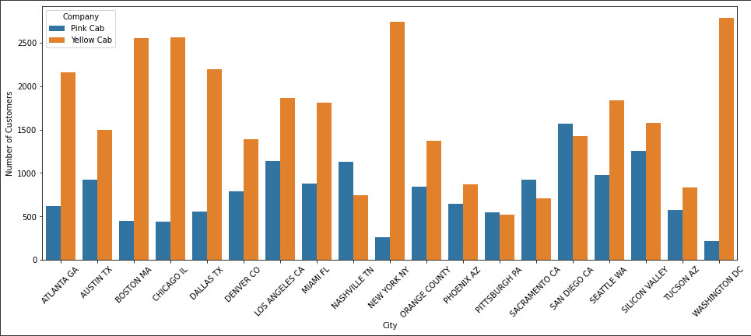
Users Covered By Company per city

Slide 11
Recommendations
We have evaluated both the cab companies on following points and found Yellow cab better than Pink cab:
Yellow cab has a higher customer base in 15 cities compared to 4 cities for Pink cab .
Yellow cab is doing far better than Pink cab in customer retention; meaning that customers return and use the same company more often
profit per KM for Yellow cab is about three times the profit per KM of the Pink cab.
Yellow cab is performing better in offering services to all income class groups (low, medium and high)
Yellow cab has more than three times the number of rides compared to pink cab, which indicate more coverage
Based on the evaluation of both companies and found Yellow cab better than Pink cab for investment and we recommended it

Slide 12
Thank You

